Slide 1



Copacabana
Data Mining
AD 699 Semester Project - Team ALPHA

Slide 2
OVERVIEW
CLASSIFICATION
01
03
DATA PREPARATION AND EXPLORATION
K-NEAREST NEIGHBORS
NAIVE BAYES
CLASSIFICATION TREE
MISSING VALUES
SUMMARY STATISTICS
DATA VISUALIZATION
MAPPING
WORDCLOUD
CLUSTERING
04
K-MEANS ANALYSIS / HIERARCHICAL CLUSTERING ANALYSIS
02
PREDICTION
MULTIPLE REGRESSION MODEL FOR PRICE
CONCLUSIONS
05
FINDINGS AND OVERALL PROCESS

Slide 3

MISSING VALUES
LISTINGS<-READ.CSV
Columns to Factors
Columns to Dates
Column to Numeric (%)
Columns to Numeric
FILTER COPACABANA
REMOVE UNNECESSARY COLUMNS
HANDLE NAs from DF
Mode, Mean, Median
na.omit

Slide 4
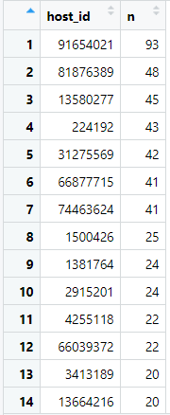

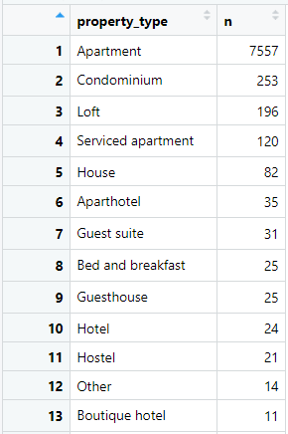
SUMMARY STATISTICS

Slide 5
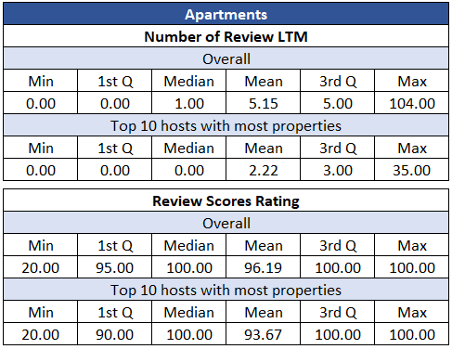
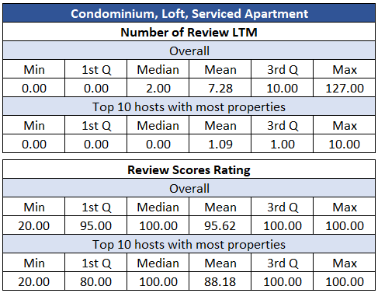
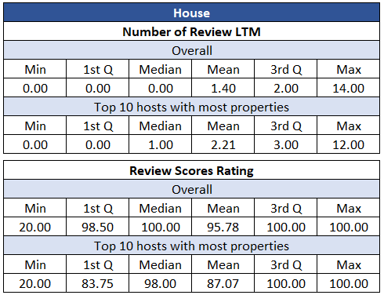
SUMMARY STATISTICS

Slide 6
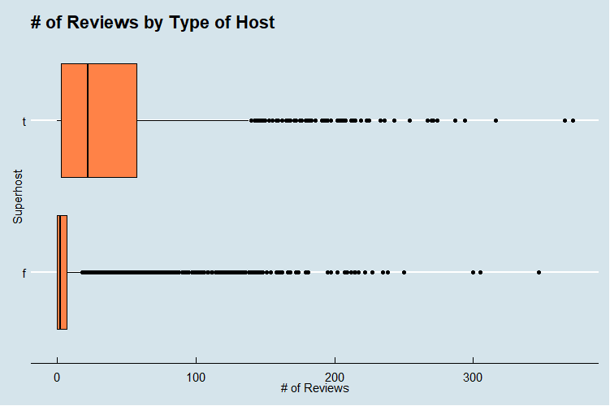
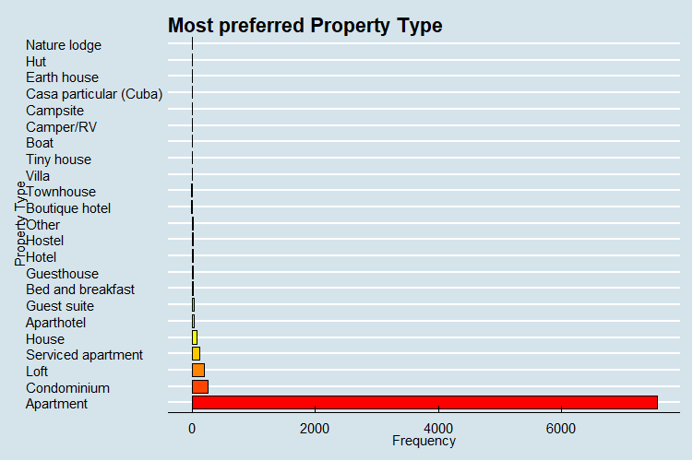
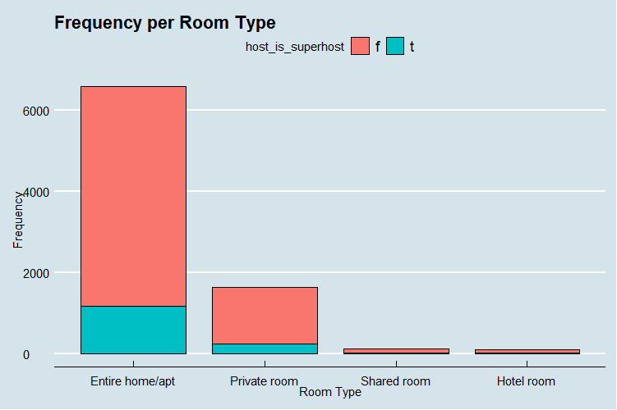
DATA VISUALIZATIONS

Slide 7
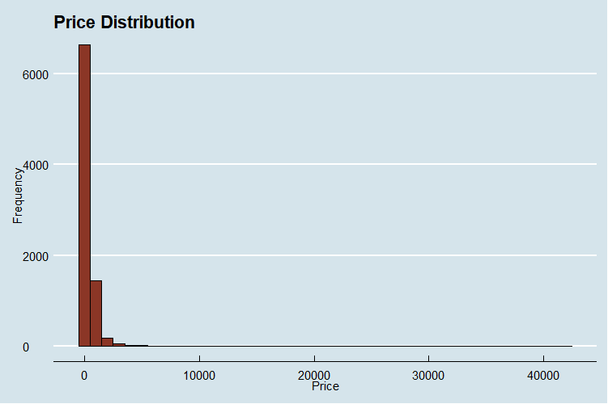
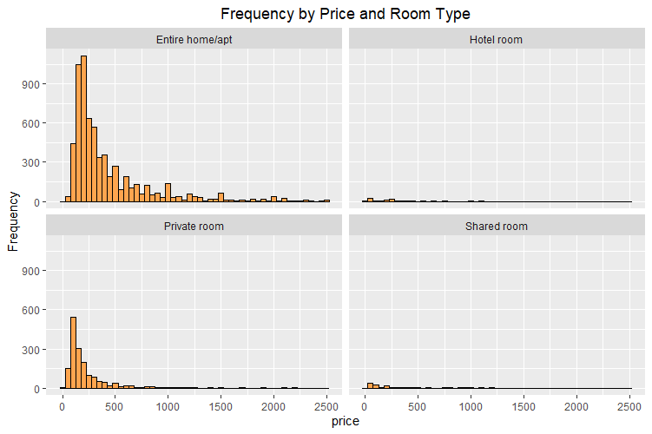
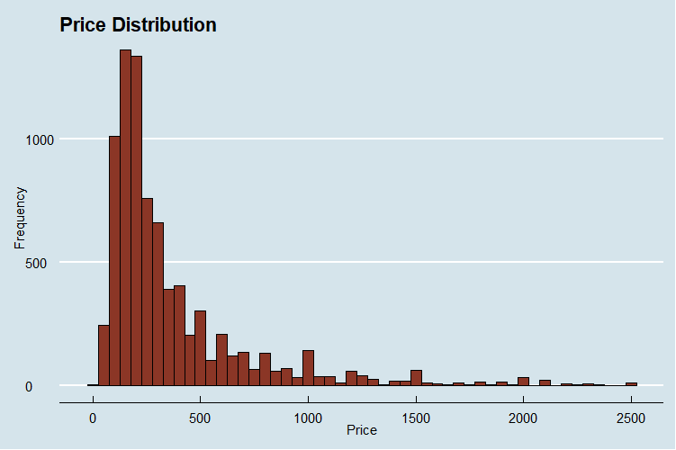
DATA VISUALIZATIONS

Slide 8
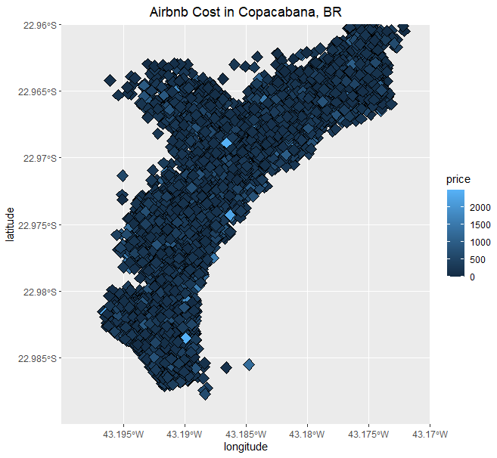
MAPPING
Geographical display of Copacabana pricing
“Heat map” to show guests the value or their rental choices
Easy price comparison to neighboring units
Quick gauge of proximity to local landmarks
Visual display of average market price
Hosts can benchmark rental price competitiveness

Slide 9
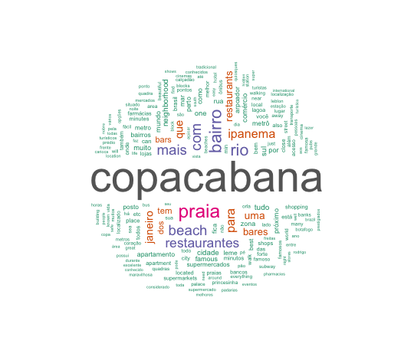
WORDCLOUD
Copacabana
Beach / Praia
Restaurantes
Ipanema
Bars / bares
Famous
Beautiful

Slide 10

MULTIPLE REGRESSION MODEL
First Regression Model
Final Regression Model
Accuracy
Select the Variables
Data Partitioning
Remove some outliers
Correlation Matrix
Backward Elimination

Slide 11

MULTIPLE REGRESSION
Equation:
new airbnb = 3.13 - 6.35(xHost response rate) - 5.93 (xHost is super host) - 3.5 (xLatitude) + 2.59 (xLongitude) - 2.11 (xRoom type hotel) - 1.70 (xRoom type private) - 1.33 (xRoom type shared) + 1.11 (xBathrooms) + 1.32 (xBedrooms) - 7.72 (xBeds) - 2.27 (xGuest included) + 3.39 (xExtra people) - 1.25 (xNumber of reviews) + 5.23 (xReview rating) + 1.57 (xReview cleanliness) - 2.08 (xReview location) - 1.24 (xCancellation moderate) - 1.05 (xCancellation strict) + 1.04 (xCancellation super strict 30) + 2.53 (xCancellation super strict 60)
35%
R Squared
316
RMSE Train
287
RMSE Validate

Slide 12
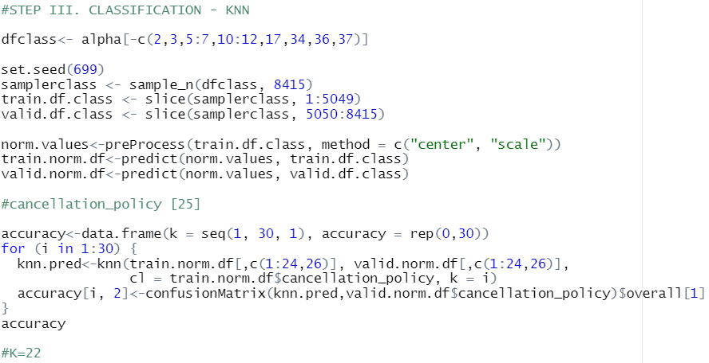
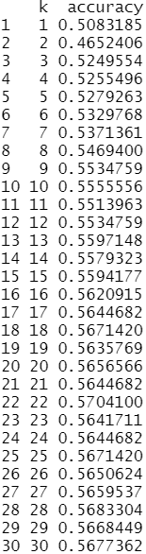
K-NEAREST NEIGHBORS
K = 22
Cancellation Policy = “strict_14_with_grace_period”

Slide 13

01. FEATURE SELECTION
02. A-PRIORI PROBABILITIES
03. FICTIONAL RENTAL
04. ACCURACY OF TRAINING & VALIDATION DF
NAIVE BAYES
Categorical Variables
User convenience, credibility of the host and guest verification
60% not bookable and 39% bookable
Assessed using predict function and conditional probabilities
Predicted not bookable - 55%
Training accuracy of 64% and validation accuracy of 61%

Slide 14
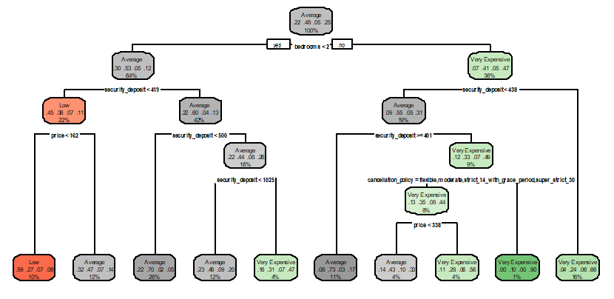
CLASSIFICATION
CP = 0.00164880, 25 splits
CP = 0.00288541, 9 Splits
Accuracy: 57.08% → 58..39%

Slide 15
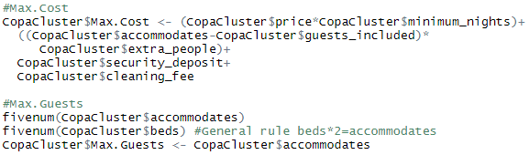
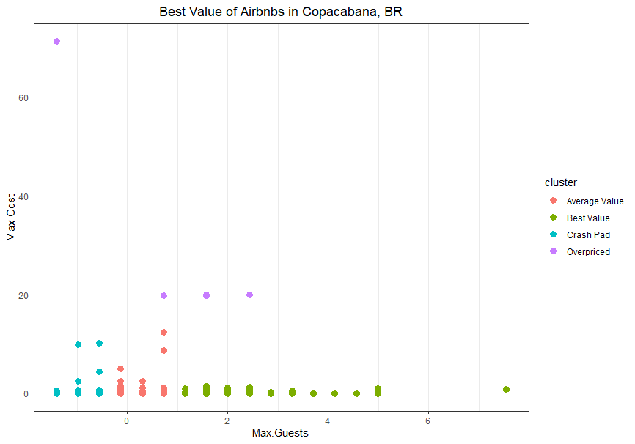
CLUSTERING

Slide 16




CLUSTERING
CRASH PAD
OVERPRICED
AVERAGE VALUE
BEST VALUE
Average cost, low occupancy
Advertise as “cozy” rentals
Market to lone travelers, business people, wedding guests
Significantly greater cost, occupancy varies
Market to guests with cash liquidity, desiring premium property near local hot spots
Average price and occupancy
These units are for couples or very small groups, who want to see the sights but don’t want to pay an arm and a leg for it
Average cost, greater to significantly greater maximum occupancy
Appeal to guests traveling in large groups looking for the lowest cost-per-head
Market to folks celebrating milestones, work retreats, etc.
Notes:
<a href='https://www.freepik.com/vectors/people'>People vector created by freepik - www.freepik.com</a>
<a href='https://www.freepik.com/vectors/coffee'>Coffee vector created by stories - www.freepik.com</a>
<a href='https://www.freepik.com/vectors/people'>People vector created by pikisuperstar - www.freepik.com</a>
<a href='https://www.freepik.com/vectors/money'>Money vector created by macrovector - www.freepik.com</a>

Slide 17

CONCLUSIONS
Preparation
Exploration
Prediction
Classification
Clustering
Removal of unwanted variables
Correct formatting for application in machine learning models
Missing values
Visualising variables helps in identifying relations between them as well as outliers
Price Map
Many variables insignificant for model's purpose → Backwards elimination
R-2 predicted only 35% of the observations → Gather information about new variables that could contribute to the model, like sq. ft
KNN Model: 57% accuracy. More data can improve the results
Naive Bayes: not bookable. Improvisation and addition of new features
Decision tree as a visual tool for prediction. But data improvement required.
Feature Engineering
4 clusters: Crash Pad, Overpriced, Average Value and Best Value
Active search
Notes:
MAPPING
The Copacabana pricing “heat map” demonstrates the value of a given rental to guests. Unit owners the information to make their pricing more competitive. Top Airbnb-competitor sites are already plotting unit prices to maps but they do not have heat maps so this help build our competitive moat.
K-MEANS
The Airbnb K-means cluster taps into the value system of a potential guest and segments listings accordingly using key rental attributes. Pitting cost against occupancy, units were grouped into four clusters; one for virtually every type of guest. We can use these clusters to push better, shrewder rental suggestions to potential customers.

Slide 18


THANKS!
Do you have any questions?
Please keep this slide for attribution.

